Slide 1
DiscoverIT Internship Detection App
George Patrașc
Ferencz Cârnu

Slide 2
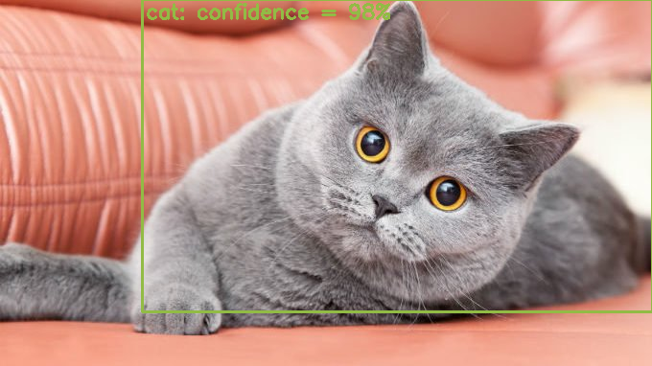
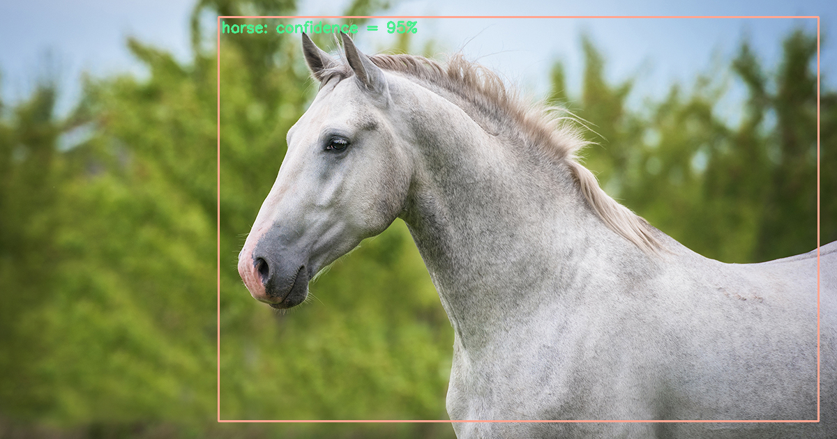
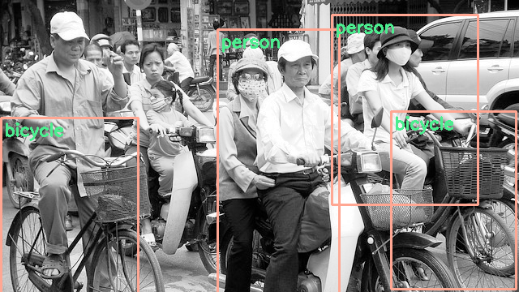
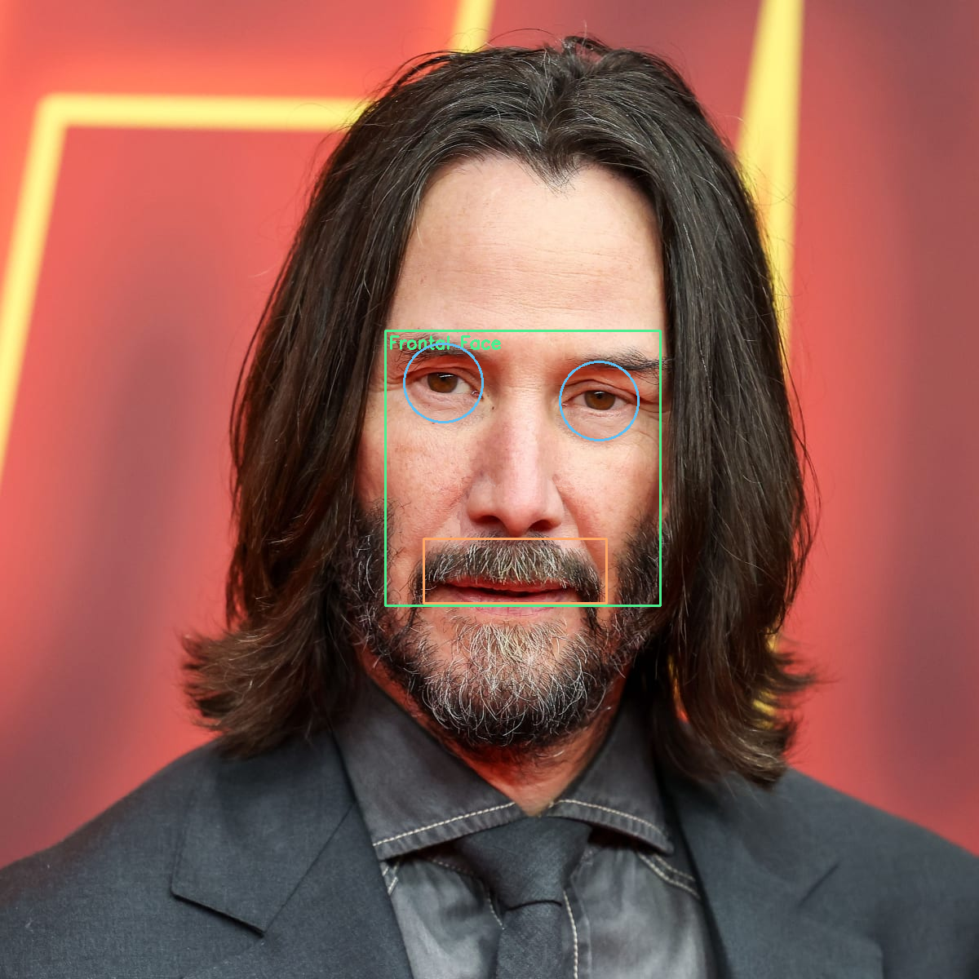

Desktop application to showcase the use of object detection models

Slide 3






Technologies used
C++ Language
OpenCV
Qt 6
Visual Studio
CMake

Slide 4
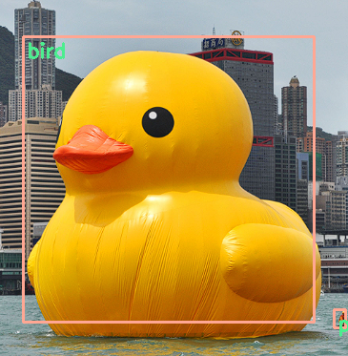
Application Overview
Our application allows users to:
interact with a webcam
capture video feed
upload still images
Users can load local model files and apply object detection to analyze the images.
They can explore basic image processing algorithms to enhance and see how they can affect the results.

Slide 5
Architecture
GUI
Main window
Menu
Status bar
The application follows a straightforward architecture
Separate components for
Graphical User Interface
Webcam interaction
Image processing
Object detection
Application
Detection
Cascade Classifiers or Neural Networks
Utils
Image processing algorithms
Frame status logic (undo/redo)

Slide 6
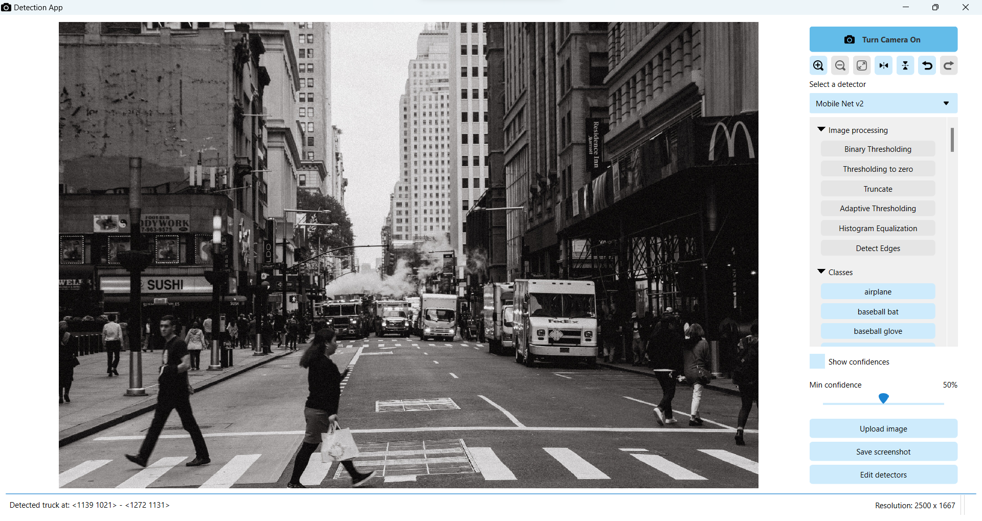
User Interface
Created with the C++ Qt Library
Styled using the QSS syntax
Components:
Image viewer
reimplemented Qt’s QGraphicsView
Custom menu QWidget
custom checkable buttons
scrollable list of available objects to detect (you can enable/disable) them
Status bar

Slide 7
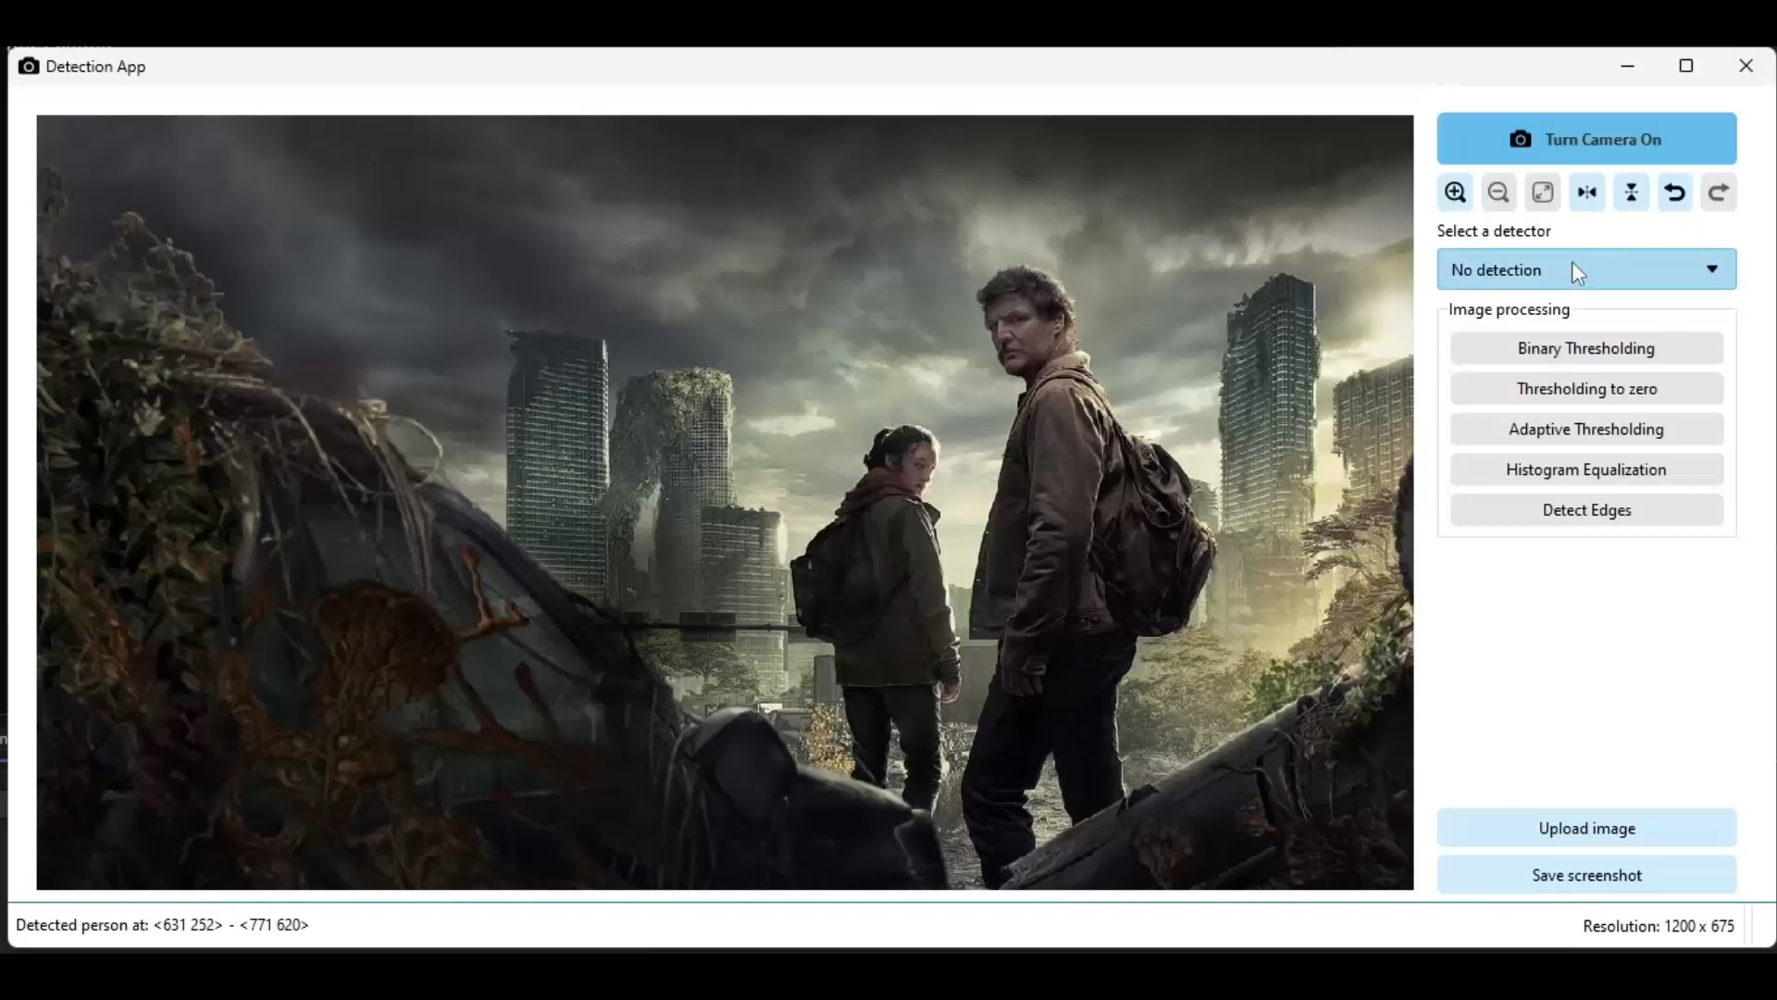
Object Detection
Cascade Classifier
single-object detector
uses haarcascades or lbpcascades
Neural Networks
multi-object detection
Requires three files: model, classes, config
You can enable/disable certain object
You can adjust the minimum-thershold

Slide 8
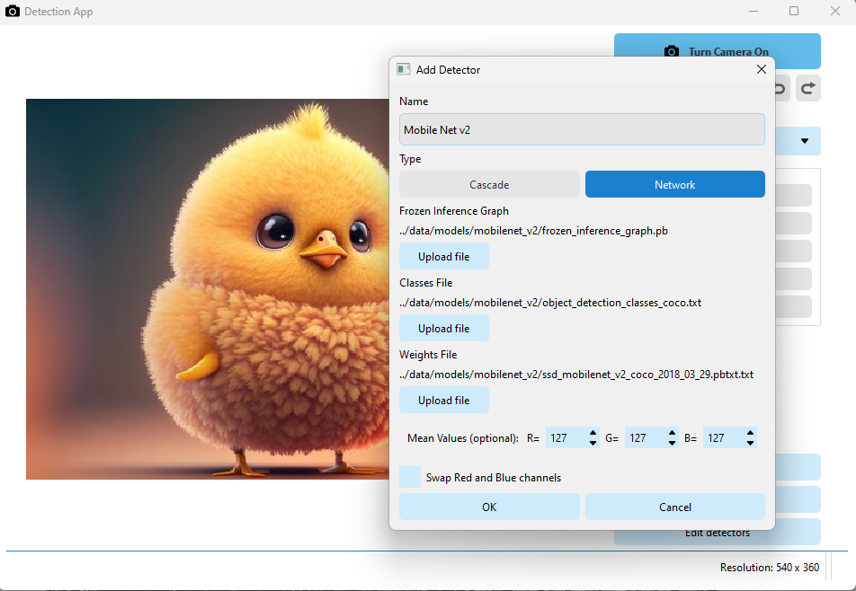

Model Loading
You can add models and specify the following properties:
Type (cascade or network)
The path(s) of the model
The mean values for the model (optional)
Whether to swap the red and blue channels (optional)
Each detector is saved in “*.yaml” file in the “detector_paths” directory.

Slide 9

Image Processing
There are different filters to enhance the image:​
Binary Thresholding​
Thresholding to zero​
Truncate​
Adaptive Thresholding​
Histrogram Equalization​
Detect Edges

Slide 10
ObjectDetection library
Follows SOLID principles:
Single responsibility principle
Open/closed principle
Liskov Substitution principle
Interface Segregation principle
Dependency inversion principle
Serializable
Detector
Cascade Classifier
Neural Network
Threshold Adjuster

Slide 11
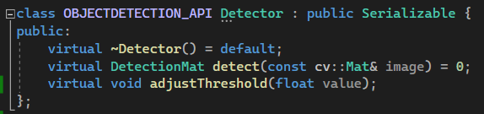
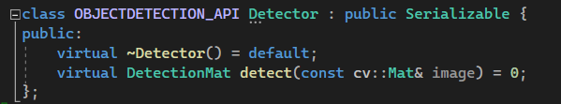
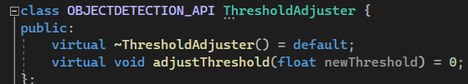
Single Responsibility Principle
Each class should have one responsibility.
S

Slide 12
Open/Closed Principle
Software entities should be open for extension but closed for modification.
O
Cascade Classifier
Detector
Neural Network
Some New Type

Slide 13
Liskov Substitution Principle
Functions that use pointers or references to base classes must be able to use objects of derived classes without knowing it.
L

Slide 14
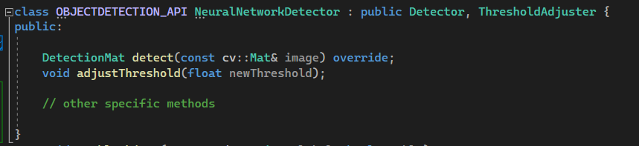
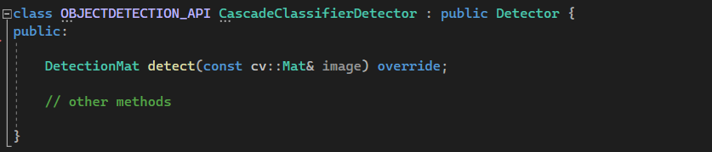
Interface Segregation Principle
Clients should not be forced to depend on interfaces they don't use.
I

Slide 15
Dependency Inversion Principle
High-level modules should not depend on low-level modules; both should depend on abstractions.
D
Application
Cascade Classifier
Detector
Neural Network
Some New Type

Slide 16
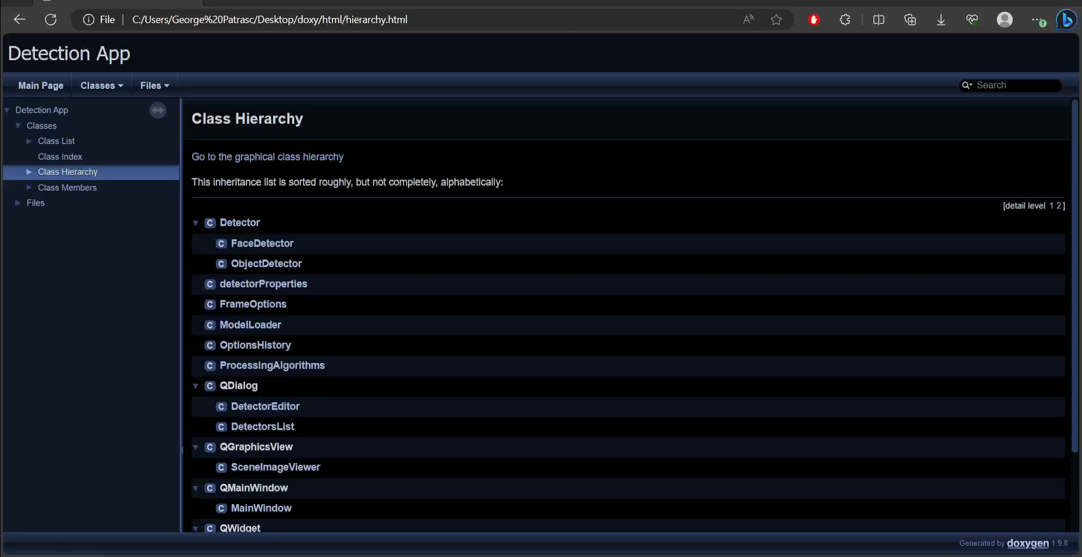
Tests and documentation
To ensure that the application does not encounter any issues, a series of Unit tests have been implemented that individually verify each component.
And to facilitate the understanding and maintenance of the code, Doxygen was used to create the documentation.

Slide 17
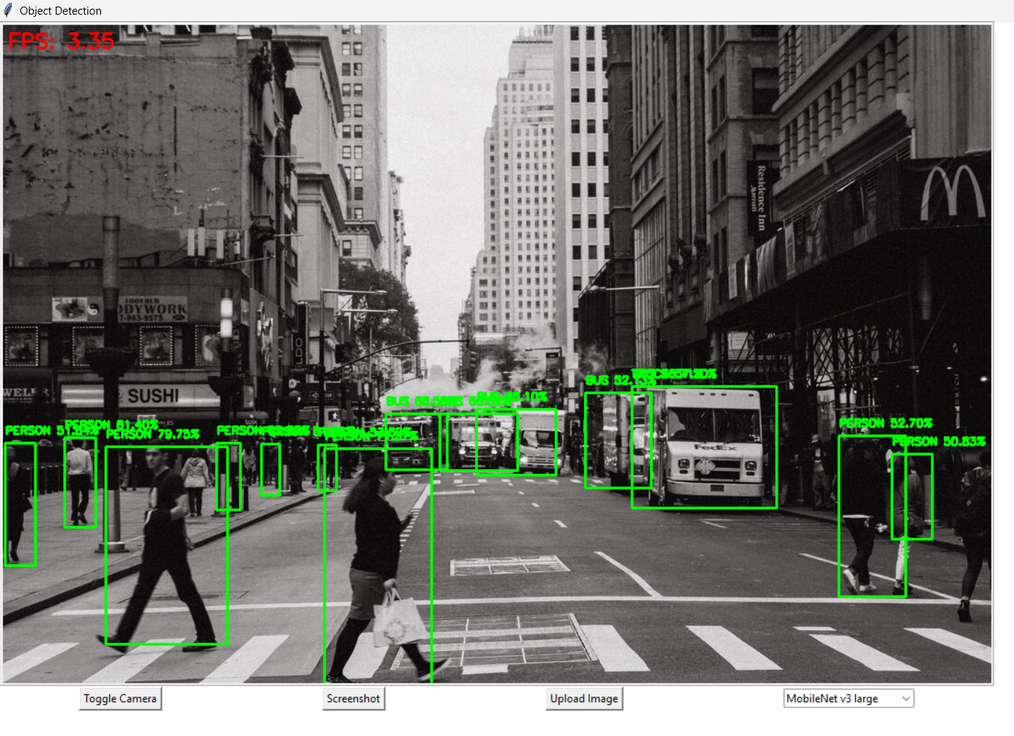
Python and Machine Learning
Python technologies were also experimented with, recreating the application in a much simpler version in this language.
Different detection models have been explored, even creating a new one that classifies an image into a certain class.

Slide 18
THANK YOU!
ANY QUESTIONS?

